Slide 1
Working in the Cloud
Notes:
Note to instructor: When you see a MIRO symbol this means there is a miro activity to support the slide with some interaction for students. Ensure you get a copy of the miro board before running the class.

Slide 2
what is the cloud?
“Cloud computing is the on-demand delivery of IT resources over the Internet with pay-as-you-go pricing. Instead of buying, owning, and maintaining physical data centres and servers, you can access technology services, such as computing power, storage, and databases, on an as-needed basis from a cloud provider like Amazon Web Services (AWS)”
Notes:
Depending on the body, institute or cloud provider you work with the definition of the cloud slightly differs. Fundamentally Cloud Services provided on demand services for compute, storage and networking. These services can be part of a Public or Private cloud offering.
- Private cloud refers to these on-demand services being made available to a dedicated customer. You may run these cloud services on-premises, in your own datacentre or have a provider provision and manage these where the services you contract to are for your exclusive use.
- Public cloud refers to services provided by a cloud provider that not only provisions the physical infrastructure for your use but other customers too. Typically this is a shared tenancy model where the underlying compute is utilised by many customers and providing more efficiency in its use, utilising it to its fullest capacity. However, note that dedicated compute is offered when there is a requirements for isolation of your processes are required.
Public cloud services provide access to their resources through ‘public endpoints’. This doesn’t mean they are open to the public as anonymous access, they are typically secure by default. It means they are available anywhere on the world – globally accessible (note with the use of the correct services it would be possible to put restrictions in place based on geolocation)
Another thing to note, the public cloud isn’t ‘Just somebody else's computer/datacentre’. This would be simple server hosting, which we have seen for decades. Its much more than that in the way we provision, manage, utilise and design our services. But it is somebody else's compute!
https://12factor.net/ for guidance on cloud native design and usage

Slide 3
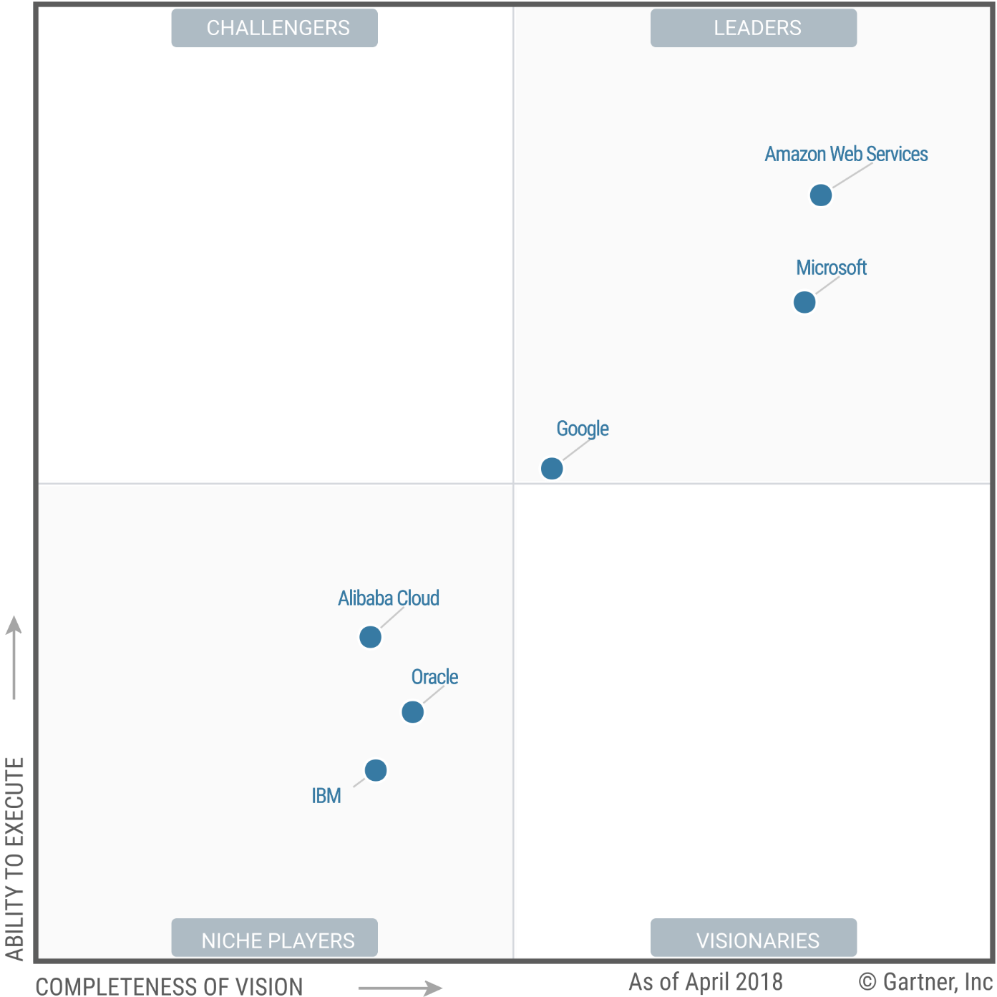
Gartner ‘Magic Quadrant’
Cloud Infrastructure and
Platform Providers
Notes:
note regarding amazon cloud service offering
AWS has consistently been at the top of the Gartner ‘Magic Quadrant’ that considers the vision of the provider around innovation and the ability for it to be provided.
https://aws.amazon.com/what-is-cloud-computing/

Slide 4
When transitioning local data architecture processes to Cloud we would consider:
functional differences in cloud computing
compute, storage choices
user role configuration
testing and visibility
Overview

Slide 5


Initiation
will the DAlc alter once in the cloud?
Analysis
Design
Build
Test
Deploy
Maintain
Notes:
deliberate repeat from earlier slides as an aide memoire
Software Development Lifecycle. A data warehouse project will be implemented in accordance with this methodology. As a result, analysis, design, build, test and deploy deliverables will need to be produced. The data analyst will be involved typically in the analysis, design and build phases of these. Source to target mapping documents start in analysis and continue through the design so that the development (build) phase has something to build from.

Slide 6
functional differences

Slide 7

operationally consume resources
variable instead of fixed OpEx model
scalability
disposability
a new cost model
Notes:
transitioning data architecture to cloud means move from a Capital Expenditure model where we have provisioned a fixed amount of compute in our datacentre, to a model where we consume the ‘compute’ provided to us in a more operational way. Variable Operational Expense is our new cost model.
What does the cloud provide to us? …. On demand resources!
Its important we use these resources correctly. We are using someone else's compute, storage , networking in a true consumption model. The more we use the more we pay. Used correctly this may to our advantage, if not we’ll have our applications constrained and not provide enough resources or over provision too much and waste money.
Scalability is an important part of using the cloud correctly. As we look at the different services available to use, for example in AWS, each services may scale differently:
Storage may automatically scale; some may shrink, some may be paid for based on the ‘high water mark’ (RDS storage for example).
A table may be able to automatically have more resources allocated and removed as demand increases or decreases.
A VM (Elastic Compute Cloud – EC2) cannot have its CPU and RAM simply increase or decrease, but the number we run can. Containers follow a similar model.
Scalability goes hand-in-hand with disposability. If we increase the number of servers due to demand, we wish to remove those servers when the demand decreases otherwise we are paying for resources that we do not use. We wish to do this in the most flexible, granular way possible. Hanging on to a server just because a user has an active session open may mean we cannot ‘dispose’ of it as quickly as possible. The design of our architecture needs to allow for this and we try to move to a more stateless model. Connections/queries are distributed across all the servers, not the individual sessions.

Slide 8
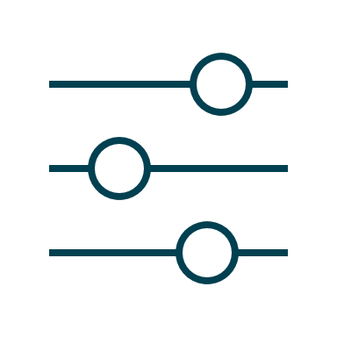
continuous resource management
options to restore or replace
servers provisioned on demand for batch processing
tweaking and optimizing
Notes:
in a stateless server environment it may be quicker to kill the server and replace with a good one. eg– what happens if a node in an Hadoop cluster has a problem? Do we keep it or kill it and quickly, within minutes, get a fresh healthy server? (consider where the data is stored, centrally or locally on the node)
this principal can also be applied to batch processing. As our data needs to be processed, does the different types of storage we use be disposed of and only loaded when needed, can the processing servers be provisioned on demand?
Consider an End of Month processing job to analyse the months data and provide a static report (no presentation layer providing dynamic querying not required). Could we provision these resources to do the days jobs and save on 30 days of cost with machines sitting idle, or storage being utilised from a batch load able to be cleaned and disposed of?

Slide 9
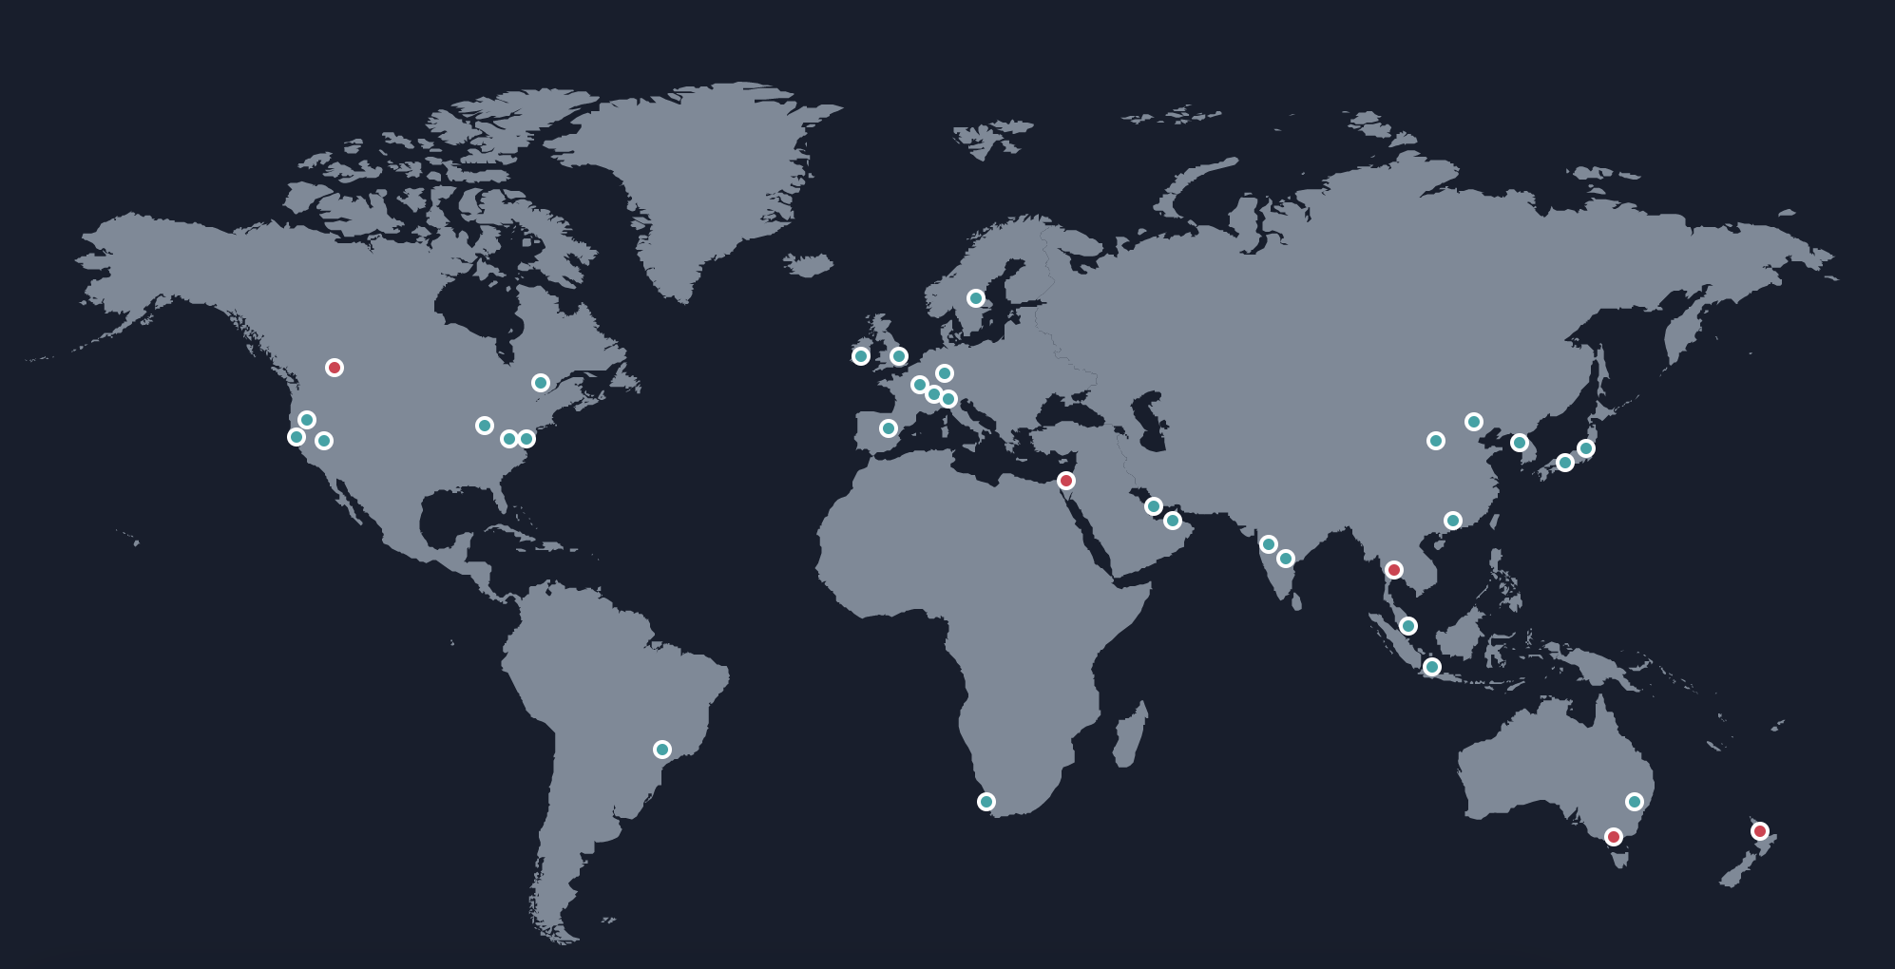
but…. where in the world is it?
image credited to : https://aws.amazon.com/about-aws/global-infrastructure/
Notes:
Image courtesy of:
https://aws.amazon.com/about-aws/global-infrastructure/
Understanding the AWS infrastructure is important in deploying scalable, resilient services well.
Servers:
The standard model in Amazons solution is that an EC2 (Elastic Compute Cloud - virtual server) is placed on shared infrastructure in a given availability zone
The other choices are:
Choose a dedicated server or instance that ensures our EC2s do not share physical compute with other customers.
Bare metal servers, similar to above, but we have greater access to the hardware and can install and configure our own servers.
(Note: we cannot pick an individual physical server in an individual datacentre, but choices influence how our EC2s are deployed)
Servers are organised into racks. Those racks contain many servers plus supporting hardware/services. As we deploy our EC2s we may need to control the relationships between the hardware and virtual machines as they are deployed – Placement Groups
Cluster : place the EC2s on the same servers(s) to minimise the latency by sharing the same bus
Spread: Ensure EC2s are on different hardware to minimise loss due to server outage
Partition: Place related servers close to each other, and non-related servers (but may have a copy of the data) on different hardware to minimise loss
Datacentres
We do not have visibility or control over the datacentres we use. They run the services and these datacentres are organised together as AZs
Availability Zones (AZ)
If the datacentres run the services, organise them into groups (buildings on a campus) and provide enough distance between each group that it has a different risk factor e.g. flooding but close enough to provide good connectivity e.g. first call returned across the network within single digit response.
AZ’s can be chosen as we deploy our services so that we can design a fault tolerant solution should the risk require that we do so (it is considered best practice).
Regions
Organise or services and AZ's into regions. Regions often, though not always, relate to a geopolitical boundary. The USA has many regions, the UK, Ireland etc each has one. The region acts as a boundary. Typically there are four factors to consider when choosing a region:
Compliance: Data sovereignty due to internal, legal and regulatory concerns mean we may wish to retain our data within a countries boarders e.g. data at rest
Services: Not all services are in all regions. They may have not been deployed to that region or simply there is no demand
Cost: The cost of running a service varies by region. See the AWS Pricing calculator https://calculator.aws/#/
Latency: Do you need to bring your data closer to your users to reduce network latency?
Global Services
Some services run across many different regions around the world at ‘Edge Locations’ to provide a global service. This may be for DNS name resolution, Route53, or for content distribution and caching services, CloudFront.

Slide 10

Shared Responsibility Model
Customer Applications & Content
Customers
Platform, Applications, Identity, and Access Management
Customers are responsible for security IN the cloud
Operating system, network, and firewall configuration
Client-side data encryption
Server-side data encryption
Network Traffic Protection
Needs to be redrawn by Publishing due to copyright
AWS Foundation Services
Compute
Storage
Database
Networking
AWS is responsible for the security OF
the cloud
AWS Global Infrastructure
Availability Zones
Edge locations
Regions
Notes:
It is important to understand your responsibility in relation to using the cloud provided. Cloud providers publish a shared responsibility model and above is an example of the AWS model.
AWS provide the physical infrastructure; compute, storage, networking etc
We consume this a virtual compute, virtual storage and virtual networking and we may then configure this to our needs. This model boundary of what makes up the services OF the cloud (cloud provider responsibility), to what we may put IN to the cloud (customer responsibility – You!) will change depending on the IaaS, PaaS and SaaS models.
As we move from an IaaS model through to a SaaS model more responsibility is taken on by Cloud Provider for those services and the customer takes less responsibility

Slide 11
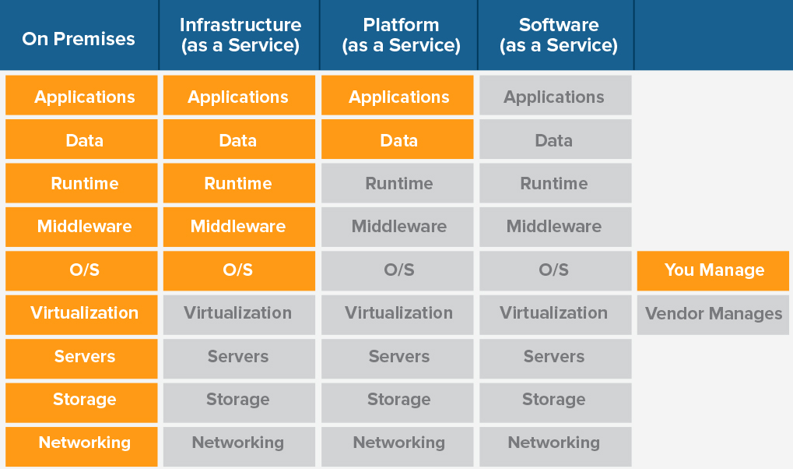
Iaas Paas SaaS
Needs to be redrawn by Publishing due to copyright
Notes:
Example of different models and responsibility

Slide 12


No Access to physical infrastructure
Presented as a virtual layer
Virtual private cloud ‘bubble’ (VPC)
networking
Notes:
When we consider networking in the cloud in comparison to doing this traditionally on-premise there are some differences to be aware of.
There is no access to the physical network, everything is presented to us as a virtual layer. This means any configuration options we have are what the cloud provider gives us.
On-premise we may also use mixtures of routers and switches to segment traffic into separate broadcast and collision domains respectfully. We do not/cannot broadcast in the cloud and do not have access to switches. All of this traffic management is done for us.
As, just like most things in the cloud, network services are based on a consumption model then often we are not restricted by the physical capacity of the network, we are restricted by the capacity of what we purchase. E.g. what is the throughput of a single NAT Gateway or a supported network speed of an EC2 instance.
It is therefore important, especially what we are talking about large volumes of data needing to be transmitted at higher velocity that we research service capacity well, otherwise we may introduce unwanted latency
A VPC – Virtual Private Cloud is AWS’s virtual network offering. The VPC is scoped to the region and is created within an account. You are allowed 5 by default but more can be requested if required.
Conceptually think of a VPC as a bubble – nothing goes in or out unless you punch a hole in it. But we want to do that very carefully as we don’t want it to burst!
If we create an Instance it must have a VPC, we cannot create an EC2 without one.
Note however that not all services sit within a VPC. Services like DynamoDB, S3 etc sit on the AWS network and do not require a VPC.
If we create an EC2 (or more) within a VPC it will likely wish to communicate with other EC2s in the same VPC, and AWS and non-AWS Services outside of that VPC.
Within the VPC, even across subnets, the EC2s can directly talk to each other. However if we wish to talk outside of the VPC we need to ‘punch a hole in our bubble’. This can be done with Gateways, VPC Endpoints, VPN tunnels and peering connections etc.

Slide 13
Cloud Providers give access via:
API
CLI (command line)
Console Dashboard
Command line access via:
PowerShell / CMD / Bash
Bastion Host / Managed Service
Cloud based shell
control and config
Notes:
The cloud provides a number of options for management.
Some prefer to use a GUI based management tool, is the provided web dashboard/console (3rd party tools exist). We simple login with our username/password and based on our current permissions we can manage the cloud services.
Others prefer or need to do their work via an API. Using a language specific SDK, which makes the crafting of the API calls easier, we can either interact with the cloud services directly to create, manage and destroy them or create programmatic solution and write applications that interact with the cloud
A variation on this is using the CLI. By using a predefined set of commands and passing API calls in the background, again we can use this to create, manage and destroy resources. We may do this as a series of one-line commands or create entire scripts that may be executed from the command line. you would need to be comfortable with CLI syntax to use this.
If we choose to use the CLI there are a number of ways we may initialise and access the command line.
The Cloud Provider may offer an ability to remote into an instance and run its CLI in a more secure and controlled way; via a bastion host (Azure – a managed jump box) or by tunnelling in the connection through a services such as AWS Session Manager. In both these cases we do not go directly to the instance but via another service where the connection can be controlled and inspected, providing another layer of protection.
A browser based option may be available in your region for the cloud provider. This enables a CLI to be opened hosted by the cloud provider and not on your local system or remote server – Cloud Shell
To give more control and flexibility, especially when wanting to interact with local tools, applications and files you may opt to have the CLI installed on your local PC or Server.

Slide 14
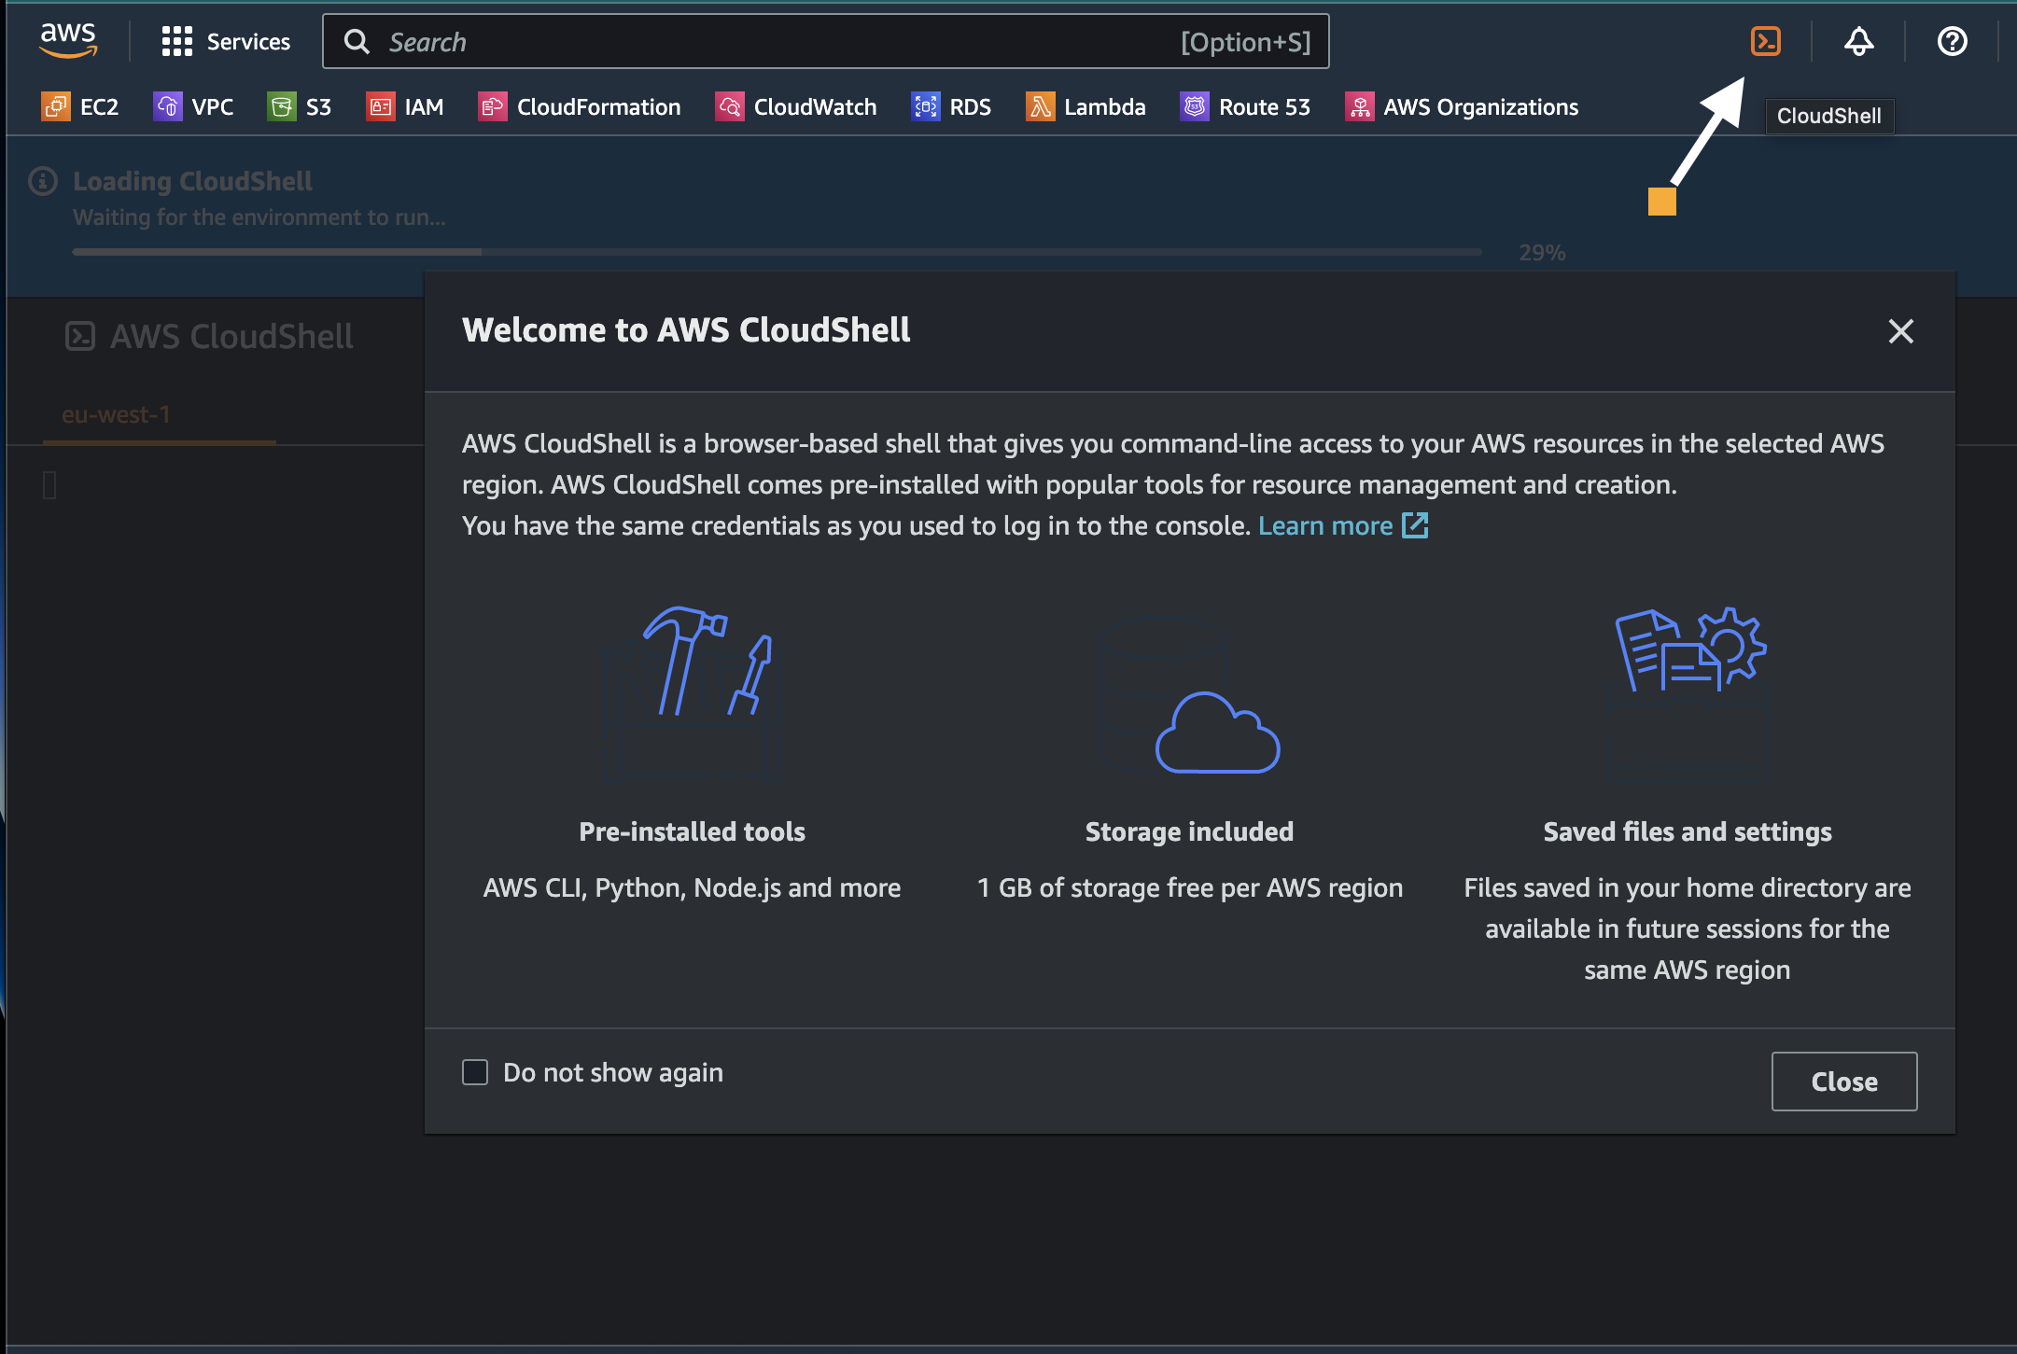
Notes:
CloudShell to provide browser based access to the AWS CLI environment – perhaps your laptop doesn’t support the AWS CLI because of security policies or you are temporarily working from another system
https://aws.amazon.com/cloudshell/
If you do not need access from your local laptop or server you may use CloudShell.
First time you select the cloudshell icon (as arrowed) an environment will be setup for you. This will provide all the tools you need to run the CLI from within a browser. You may now mange the cloud environment in a similar way to running the CLI from your local machine.
The shell will run in the security context of your user or role you are currently using. There is no need to setup credentials.
OR if you want to install and use the CLI from your local machine:
When using the cli the first thing to do is to do the setup.
The AWS CLI files for credentials and configuration are stored within a .aws hidden folder that is in the root of you Linux home directory or the root of the windows profile.
These files can be edited directly but may be setup using AWS Configure. The credentials are setup by passing a Key and Secret that is created for the purpose of programmatic access from within the IAM console. The config file can be used to setup extra profiles, set output, default region etc
Running AWS configure and providing credentials at each prompt: (if you make a mistake, run AWS configure again to pass correct values in)
[ec2-user@ip-10-1-1-149 ~]$ aws configure
AWS Access Key ID [None]: AKXXXXXXXXXXXXXXYAZ4
AWS Secret Access Key [None]: YkF0XXXXXXXXXXXXXXXXXXXXXXXXKpz
Default region name [None]: eu-west-1
Default output format [None]:
[ec2-user@ip-10-1-1-149 ~]$
https://docs.aws.amazon.com/cli/latest/userguide/cli-chap-configure.html

Slide 15
initialising
Notes:
when you set up your vpc you will need to make choices about the data architecture including the servers and services – although they can be added over time

Slide 16

Example : EC2
Compute optimised
or
Memory optimised
or
Storage optimised
What kind of server is needed?
Notes:
EC2 - a virtual server that you may configure as you wish. https://aws.amazon.com/blogs/aws/choosing-the-right-ec2-instance-type-for-your-application/
Note: we also say EC2 instances, there are other types of instances, RDS instances – we cant configure these exactly as we wish, these are a PaaS offering
Lambda – a Function as a Service offering. An event driven function service that runs and hosts your code
Container – You may have heard of docker containers? A form of application virtualisation that provides a standardised, portable environment to run your application code on top of compute.
Virtual server may seem vary familiar to a lot of people as they are common place in on-premise server rooms and data centres as well as used on peoples own laptops to create extra working environments.
In the AWS cloud these servers are implemented as EC2s. They can be provisioned with the configuration of your choice, within the limitations of the service, and can be made fault tolerant and scalable as you increase the number of instances. As these are Infrastructure as a Service (IaaS) models then you have the greatest level of control.
You may place you EC2 in a single AZ or spread multiple instances across AZs for greater resiliency.
When choosing to use an EC2 and ‘Launch Instance’ the common option is to create an on-demand instance. This is a true PAYGO model and you pay by this instance or the hour depending on the AMI chosen. This will remain in place until you terminate.
Other billing options include :
To save around 70% of the on-demand price you may contractually agree to pay for an instance (Reserved Instance) or a monthly amount (savings plan) for either 1 or 3 years.
or you may ‘bid’ a price to get a spot instance and save over 80% on the on-demand equivalent cost. However spot instances can be taken away from you if either the price increases and your bid is not great enough or AWS want the instance back due to high demand.

Slide 17


computational resources needed to do any task in the cloud
processing power
temporary memory
for example, a machine learning application with 3d graphics will consume CPUs, RAM and Graphic processing units to complete the task
compute
Notes:
Compute is provided as an Instance Type – Size & Family
Core count
Memory size
Storage size and type
Network performance
CPU technologies
Choosing an instance type is important as we want the correct type of compute and size. https://aws.amazon.com/ec2/instance-types/
Not only think about the amount of RAM or CPU that you require but that balance between them, perhaps you need proportionally more ram for that working set of data in memory? Maybe your working set is relatively small but perform a series of on-the-fly calculations against it. Different families have a different balance to be optimised for a particular role. They also relate to the type of processor being used: intel, AMD, Graviton ARM processors or derivatives of any of these.

Slide 18
General Purpose: M5, T3
Compute-Optimized:
C5
Memory-Optimized: R5 z1d, High Memory
GPU Intensive: P2/P3, G3, F1
Storage
H1, I3, D2
Optimized: H1, I3, D2
ec2 family types
Notes:
Here is an example of EC2 family types.
For further reference see:
https://aws.amazon.com/ec2/instance-types/

Slide 19
vCPUs | Memory (GiB) | Network (Gbps)
2 | 5.25 | Up to 25
4 | 10.5 | Up to 25
8 | 21 | Up to 25
16 | 42 | Up to 25
36 | 96 | 50
72 | 192 | 100
instance sizes
large
xlarge
2xlarge
4xlarge
9xlarge
18xlarge
Notes:
Traditionally we calculated the amount of resources, CPU & RAM, the processor type that was appropriate and placed an order for physical computer. Then some 2-3 months later it arrived, and if luck only a few more weeks to get it installed and configured. Unfortunately we my have then found out we got the spec wrong!! ….. Ooops! (requirements do change)
Not to worry, were in the cloud. Change out mind as requirements change we can change our instance type. It may be family because our Database access pattern is different and now I need more of a CPU balance than RAM. Or maybe I just need more.
Sizes are based around T-shirt sizing: S M L XL XXL etc. Typically as you go to the next size resources double. But this is not always the case – do your research!
If you do need to change your mind then a reboot will be required so that it may find that new hardware on a new server. But it is just a reboot of the EC2, not a complete rebuild

Slide 20
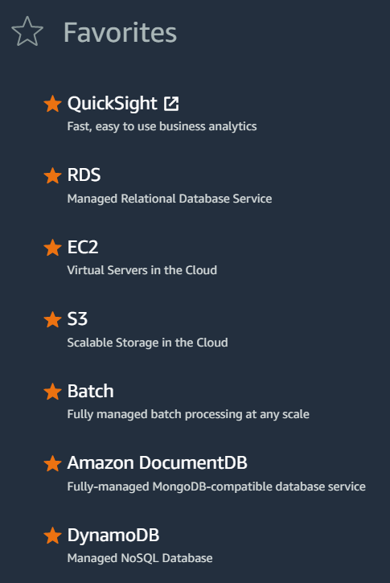
other AWS SERVICES
Notes:
shown on this slide are some of the aws services that could be set up as part of the data architecture

Slide 21


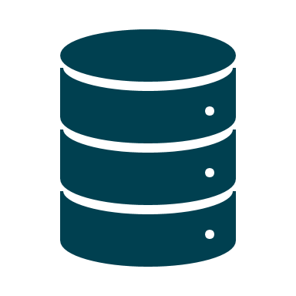
getting data into the cloud
Notes:
5 Ways To Load Data Into AWS | Integrate.io
Easily ingest data into AWS for building data lakes, archiving, and more | AWS Storage Blog (amazon.com)
aws storage gateway
aws data sync
aws snowcone and snowball , snowmobile

Slide 22
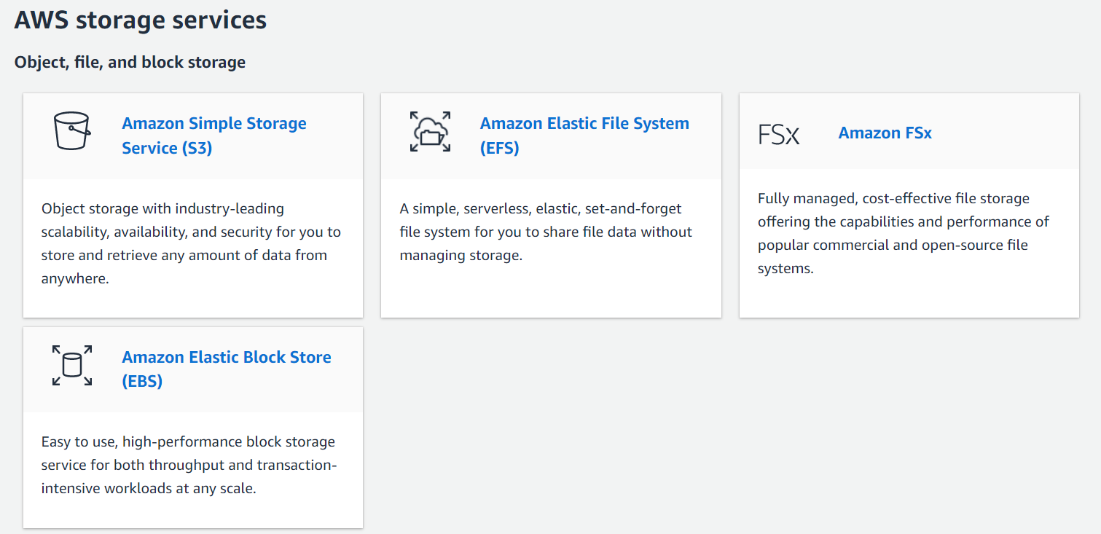
categories of storage
Notes:
object storage
file storage
block storage
all have different considerations and strengths
Object storage- huge amounts of unstructured data like videos and sensor data, web searches. object storage is scalable and efficient because it keeps the files in their innate format, within buckets which can be expanded and collapsed as required. does not need the detailed design / mapping work which you would expect in a DWH scenario and formats of stored data can be mismatching..
File storage
data stored in a hierarchical folder and file format., known as a network-attached storage (NAS) server with common file level protocols used in Windows instances and found in Linux.
Block storage
commonly used for enterprise resource planning (ERP) systems that need storage that is well organised – it is possible to quickly retrieve specific data from the blocks which are uniquely labelled.
scenarios: https://aws.amazon.com/what-is/cloud-storage/
Analytics and data lakes
Backup and disaster recovery
Software test and development
Cloud data migration
Compliance
Cloud-native application storage
Archive
Hybrid cloud storage
Database storage
ML and IoT

Slide 23
users + roles

Slide 24

Cloud Providers require a user database
Hosted within the cloud
users with access to the Cloud Services
users with access to cloud hosted applications
Users from On-Premise – federated
Active Directory
Other IdP (Facebook, Gmail…)
user database options
Notes:
As we transition from running our services on-premise and in our own datacentre its not just their applications, services and data we need to consider – its users for Authentication AuthN and Authorisation AuthZ. We need to prove who we are and control access via ACLs Access Control Lists.
One of the most popular directory services for Corp environments is active directory. It is a database of users to control AuthN, groups to help organise the users. This means we can give permissions to groups rather than individuals which is cumbersome. These permission we grant control AuthZ.
As we move to the cloud we can still use these users & groups as we implementation Identity Federation. Using a defined protocol, we can use SAML and OIDC standards to pass credentials and their details from on-premise servers, such as Active Directory Domain Controllers to the cloud identity services. Typically we map a user in the local system to a user or role in the cloud.
Within the cloud we need a database of users (groups and roles too) that control AuthN and AuthZ to the cloud services. We must not forget, not only do we need to control access to cloud services but also the applications built from them. The users that consume the applications will be separate from those that create, administer, maintain and delete compute resources.
AWS approach these two scenarios of ‘cloud users’ is to provide a set of managed services.
For federation, AWS SSO provides a single sign on capability without you having to manage your own servers. This has recently been renamed to ‘Identity Centre’
If you do not wish to use a federated option but run Active Directory in the cloud, AWS provide Managed Identity services.
For controlling access to AWS services, login / authorisation, we have Identity Access Management services – IAM
Those that wish to have a separate set of users, perhaps creating a different user base for different applications, we have Cognito. Not only can it be a database of users and control AuthN but can also be federated. For example I could give a subset of users from Facebook access to my application. Facebook acting as the Idp (identity provider) provides AuthN and we control access to resources (our application) AuthZ

Slide 25
Can integrate with federated access
Made up of IAM Entities:
Users
Groups
Roles
Policy based access control
identity access management
Notes:
Our main focus in this section is IAM. It will be our primary method of authentication to our services.
IAM is scope to the account – if you have a different account (an AWS Tenancy) then you have a different pool of users/groups/roles. Whilst this service is unique to each account, which is to our benefit as we can create separate security boundaries, we have to be aware it’s a global service. If you believe that you ‘create a user in the UK’ you are actually not, you are creating a user available worldwide in all regions.
The different type of entities we can have are Users, Groups and Roles. These help to manage identity. We also have IAM policies that help to manage access to resources.

Slide 26
Users
Console access – username/password
Programmatic access – Key / Secret
Key/secret may be used by human with the CLI
Key/Secret may be used with application/service making API calls
Groups
Used to organise users by similar need, requirement or access
Roles
A temporary identity that uses a memory resident key/secret
Role may be used by a user to change their security context
A Role may be used by a Service to provide an Execution Context
users groups and roles
Notes:
Users are about providing credentials to AWS to allow access to the AWS platform.
If you wish to login to the console you will create a user with a username / password. Either additionally or as an alternative that user may be given a key / secret that is used for programmatic access, for example configuring the CLI. We are not all humans – we can be applications and services. These need identity too! A key & secret combination can be used within your application code (though not embedded within it – bad security) so that any calls to an AWS service can have an ID passed.
Groups are just groups of users. We create the group for a particular need/role, add the users to the group and then grant permissions to the group and not the individual user (unless an exception needs to be made).
The icon for the Role is a Worker Har. This describes how roles should be used – to do the work. A user may login, but then switch to a role to provide a different security context with different permissions to do a particular task or job role.
When services run, some need a specific role assigned to them so as they execute and perform tasks. They have an ID and permissions assigned to make such calls.
For example we give a Lambda function a specific role, so that role may have permissions assigned to it. This could allow the Lambda when executing its code to call on and access a database.

Slide 27
ongoing visibility

Slide 28
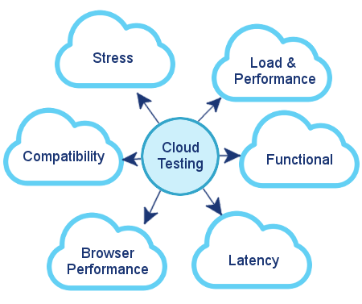

testing
Needs to be redrawn by Publishing due to copyright

Slide 29


Verification
Validation
Validation vs Verification
The process of checking that the system has been built according to specification.
The process of checking that the systems meets the customer’s needs.
Notes:
deliberate repeat of day 3 content – this will be different now that we are working virtually

Slide 30
Functional
Requirements
Non-functional Requirements
What is being Tested?
(The ‘what’)
(The ‘how’)
What the system must do
Inputs
Outputs
Reports
Business rules
Compliance
Calculations
Transformations
Translations
Performance
Usability
Accessibility
Capacity
Maintainability
Reliability
Scalability
Availability
Flexibility
Security
Portability
Interoperability
Reusability
Notes:
repeat of day 3 content – discuss as a class – based on what we have learnt, how could this look in the cloud ? anything we want to find out more about ? if yes, set some time for research and presentations back to class

Slide 31
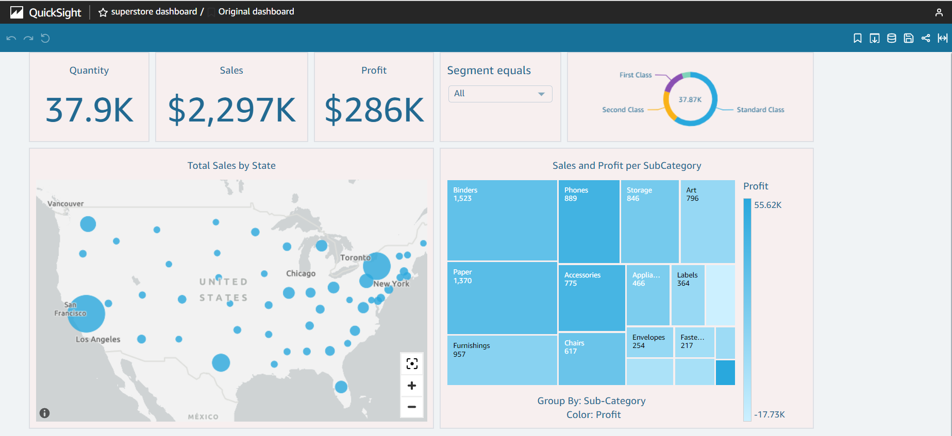
data visualisation in the cloud
Notes:
screenshot from quicksight showing the dashboard over the superstore database

Slide 32
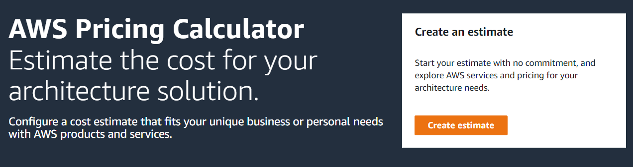
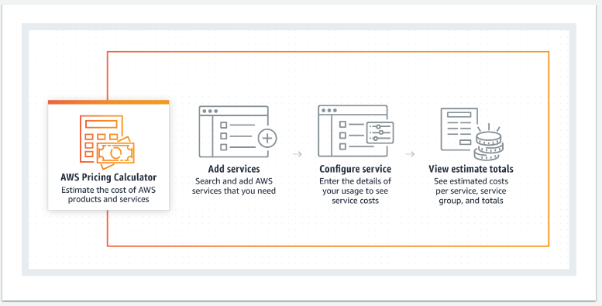
usage monitoring
https://calculator.aws
Notes:
you can use this calculator to estimate the ongoing costs of your chosen data architecture

Slide 33
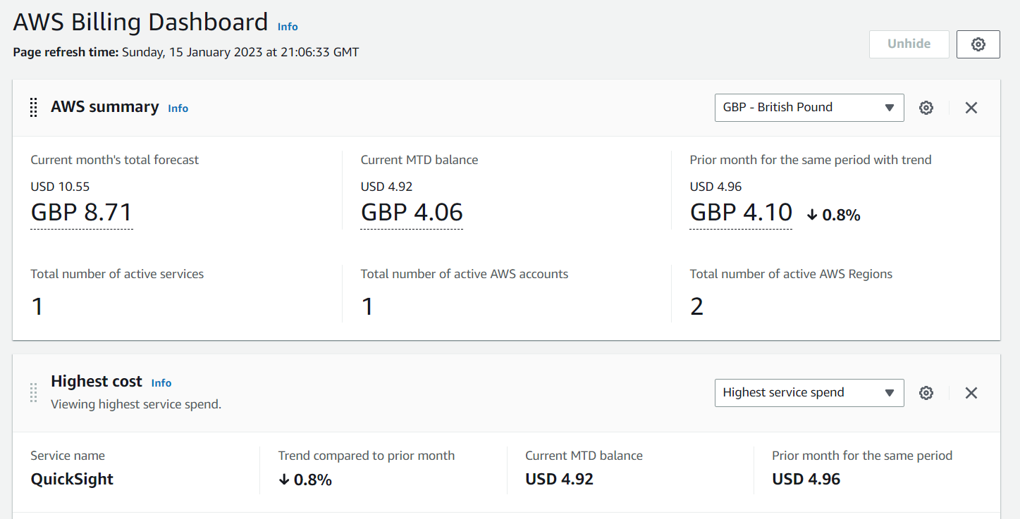
billing
Notes:
screenshot from instructors billing dashboard – use this as a discussion starter – note that with our vpc we have nice ongoing cloud monitoring capabilities over costs, trends M2M

Slide 34
first steps with AWS

Slide 35
log into your console

